Slide 1

Efficient asynchronous state management with
TANSTACK QUERY

Slide 2
Table of contents
Javascript Foundation Elements
Two Type of value in javascript
How Async Function Work

Slide 3
Javascript’s Foundation Elements
JavaScript's foundation rests upon its core components -
Heap
Call Stack
External Web APIs
Callback Queue
Event Loop
They are essential for executing asynchronous operations and managing memory within the runtime environment.

Slide 4
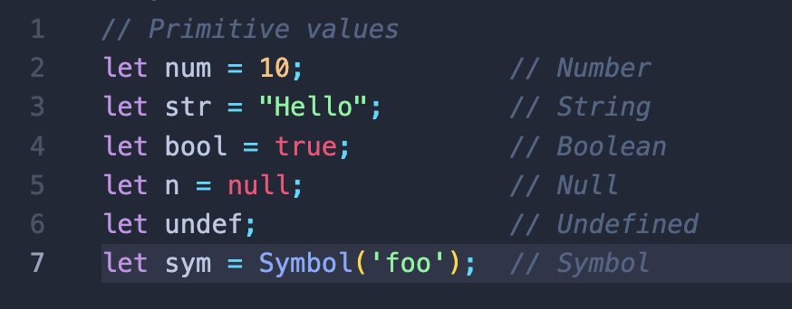
Two Type of value
Primitive Values
Primitive values are immutable, meaning they cannot be changed.
The primitive types in JavaScript are:
Number: Represents numeric values.
String: Represents textual data.
Boolean: Represents a logical value - either true or false.
Null: Represents the intentional absence of any value.
Undefined: Represents an uninitialized variable or missing property.

Slide 5
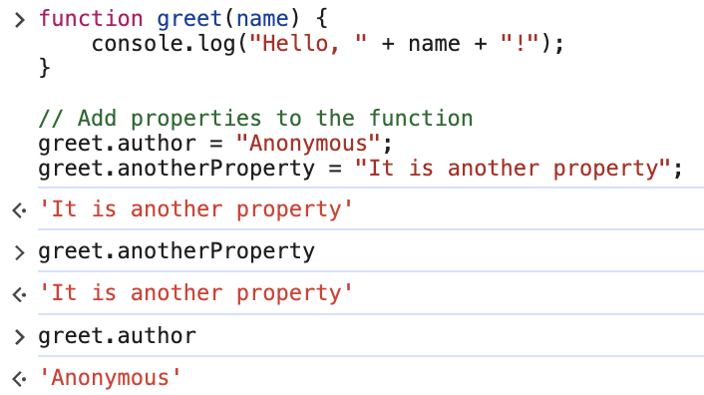
Two Type of value
Objects and Functions
Objects and functions are reference types in JavaScript.
Objects are collections of key-value pairs.
Functions are a special type of object that not only perform tasks but also hold additional properties like regular objects.

Slide 6
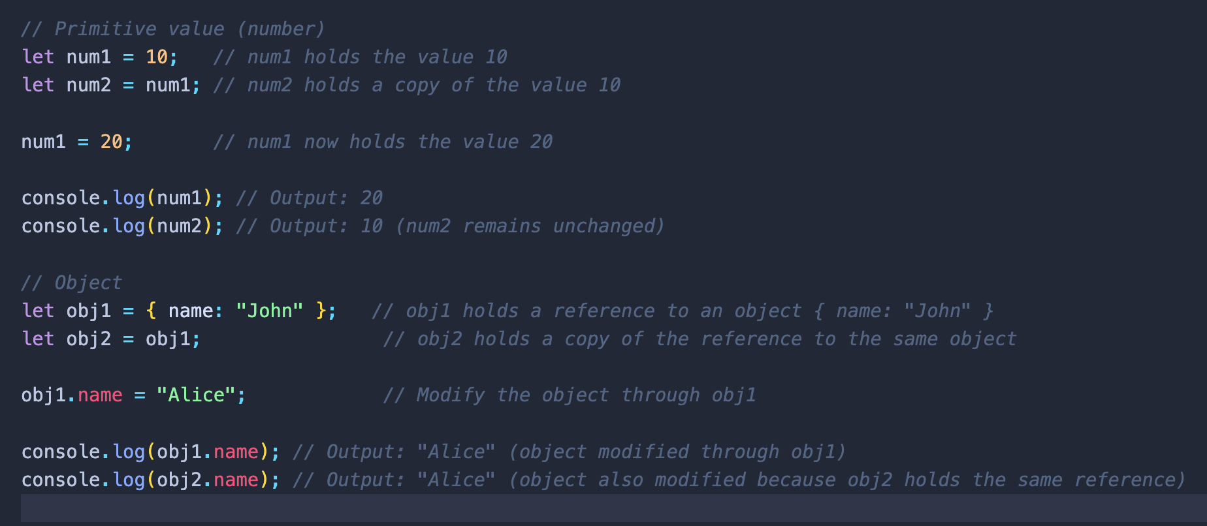
Main difference between Primitive Values and Objects/Functions
The main difference between primitive values and objects/functions lies in how they are stored and manipulated in JavaScript.

Slide 7
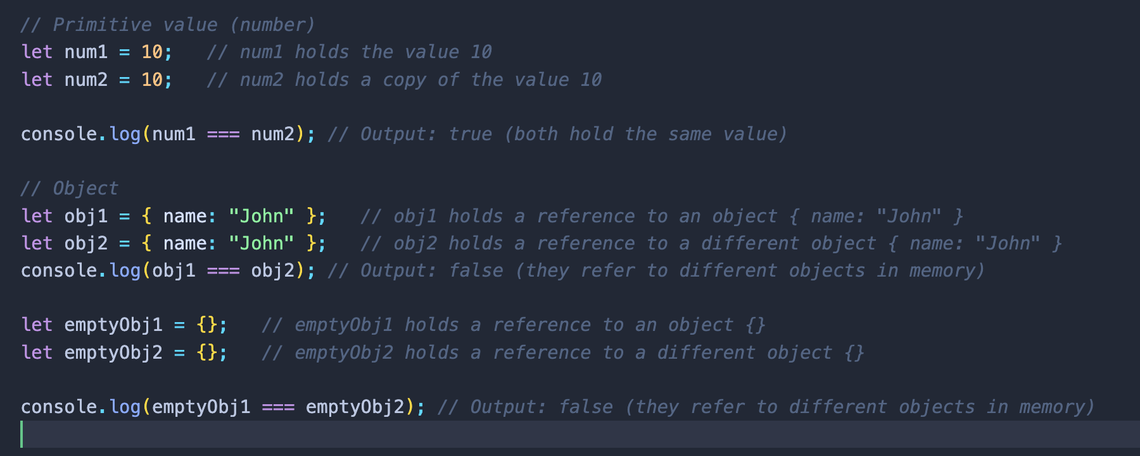
Another Example
Even when structurally similar, Objects are created anew each time resulting in distinct instances in memory.

Slide 8
Javascript’s Foundation Elements
Heap
Heap Memory:
The heap is a region of a computer's memory where dynamic memory allocation occurs. It's a large pool of memory that is used for storing objects and data structures that are created during program execution.
They are store in the computer RAM.
Address | Value
0012CCGWH80 | { name: 0012CCGWH81, age: 0012CCGWH82 } “John” 30
obj
0012CCGWH81
0012CCGWH82

Slide 9
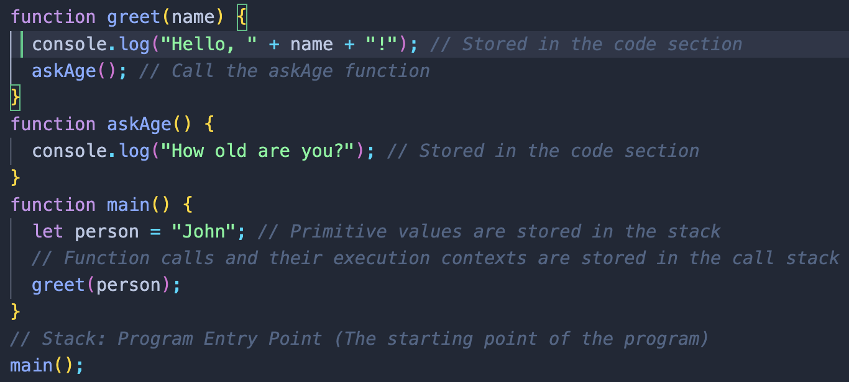
Javascript’s Foundation Elements
Call Stack
Call Stack is a concept created to trace functions.
It works with the “ LIFO “ concept (Last In First Out), that is, the last function that enters the Call Stack is executed first.
Call Stack
Call Stack
Call Stack
Call Stack
Call Stack
Call Stack
Notes:
The stack is the memory in which the data of the variables is stored ( name and value if Primitive, name and address if Non-Primitive ).
askAge()
greet()
greet()
greet()
main()
main()
main()
main()
main()

Slide 10
External Web APIs
When the call stack encounters an asynchronous function like XMLHttpRequest, fetch , setTimeout , and Web Storage API, it push the operation to the Browser provided Web Api for processing.
After processing the asynchronous operation, the Web API returns a Promise, that may either resolve(.then) or reject(.catch). Subsequently, any associated callback functions are pushed to the callback queue for execution.
Javascript Runtine
Browser Provided
Web APIs
Heap
Call Stack
(Memory Allocation)
(Function Call)
Timers(setTimeout())
{
name: "John",
age: 30
};
setTimeout()
fetch()
fetch()
showText()
return the callback function to
console.log()
Callback Queue
main()

Slide 11
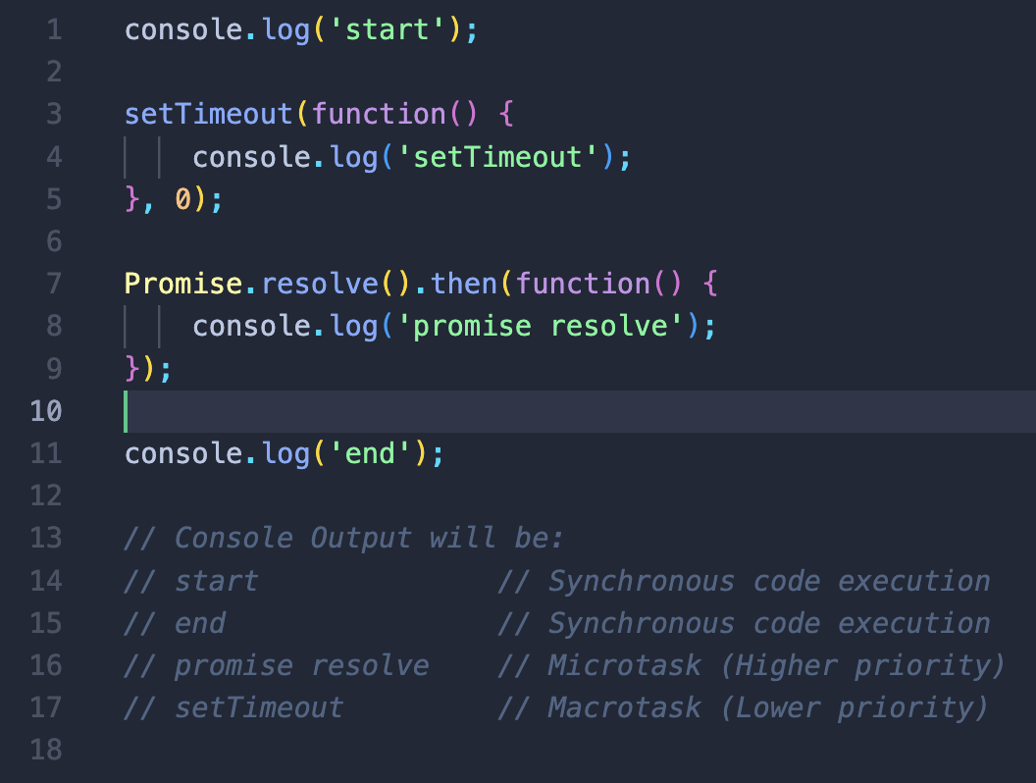
Callback Queue
The callback queue is a queue (a data structure) in the JavaScript runtime environment that stores callback functions.
Callback functions are functions that are scheduled to be executed asynchronously, typically in response to events or asynchronous operations like timer callbacks, I/O operations, or network requests.
The callback queue comprises two types of queues: the callback queue(Macrotask Queue, task queue), and the Microtask queue(higher priority queue, promise queue).
Microtask Queue store return function from promise like Promise.resolve, Promise.reject and fetch,
Callback Queue store non return promise function like setTimeout(), setInterval()

Slide 12
Event Loop
The event loop is a vital component of the JavaScript runtime
It continually monitors the call stack and the callback queues to determine which tasks to execute next.
If the call stack is empty, the event loop examines the callback queue for any pending callback functions. When the event loop finds a callback function in the queue, it moves the function from the queue to the call stack to execute.
This process repeat to ensure that asynchronous tasks are executed in the order they were scheduled.
Event loop also determines the order of tasks to push onto the call stack based on their priority and the type of task queue they belong to.

